Slide 1
CRICKET DATABASE SYSTEM
team:
YAFFIN S [RA2211032010053]
SAKINA RIZVI [RA2211032010073]
MITUN M [RA2211032010090]

Slide 2
INTRODUCTION
A Cricket Database System is a vital tool for efficiently managing and organizing the data associated with the sport of cricket. With cricket's widespread popularity and rich history, such a system becomes indispensable for players, coaches, analysts, fans. This comprehensive system encompasses key components such as player information, team management, match details, tournament information, umpire and official records, analytics, and reporting. It provides a centralized platform to store and retrieve detailed player profiles, team statistics, match outcomes, tournament schedules, and more.
PROBLEM STATEMENT
The problem in cricket database management is the lack of a centralized system, causing manual errors and hindering data accessibility. Inconsistencies and security risks arise, impeding effective decision-making and insights into player and team performance.

Slide 3
PROBLEM DEFINITON
CHALLENGES:
The problem that a Cricket Database System aims to address is the lack of an efficient and centralized means to manage and organize the vast and intricate data associated with the sport of cricket. Without such a system, there are challenges in maintaining comprehensive records of players, teams, matches, and related statistics. The absence of a structured platform makes it difficult for stakeholders, including players, coaches, analysts, fans, and administrators, to access and analyze historical and real-time cricket data easily. Manual record-keeping may lead to inaccuracies, and the absence of a standardized system can impede data-driven insights and decision-making processes.

Slide 4
PROBLEM DEFINITION
SOLUTION:
The solution to the challenge of inefficient cricket data management lies in the development and implementation of a robust Cricket Database System. This system serves as a centralized hub, meticulously organizing comprehensive information about players, teams, matches, and statistics. By creating an intuitive and user-friendly interface, accessible to players, coaches, analysts, and administrators, the system ensures ease of use and widespread adoption. Detailed player profiles, team management modules, and match scheduling functionalities contribute to a comprehensive and well-structured database.

Slide 5
PERSONA
Persona Name: BCCI
Background: The Board of Control for Cricket in India (BCCI) is the national governing body for cricket in India. It was established in December 1928 as a society in British India and became a full member of the International Cricket Council (ICC) in 1926. The BCCI is responsible for organizing and promoting cricket in India and representing the country in international cricket forums.
Needs and Goals:
Player Performance Analysis: Requires detailed and up-to-date statistics on individual player performances, including batting averages, bowling figures, and fielding records, to assess strengths and weaknesses.
Team Management: A comprehensive team management module is essential, including information on player availability, fitness status, and historical team statistics, to optimize the team composition for each match.
Match Analysis: Real-time match data, including scores, key events, and player contributions, is vital for in-depth match analysis to identify areas for improvement and strategic adjustments.

Slide 6
PROBLEM STATEMENT CANVAS
CONTEXT: The context of a Cricket Database System lies in the need for a comprehensive and organized platform to manage, store, and retrieve vast amounts of data related to the sport of cricket. | PROBLEM: The problem in cricket database management is the absence of a centralized and efficient system, leading to manual record-keeping issues, inconsistencies, and team, match, and statistical data. | ALTERNATIVES: A streamlined and secure cricket database management solution is needed to address these challenges and provide a centralized, user-friendly platform for efficient data storage, retrieval, and analysis within the cricketing ecosystem.
CUSTOMERS: Players, Coaches, Administrators, Analysts, Fans | QUANTIFIABLE IMPACT: Improved Decision-Making, Efficient Tournament Management, Accurate Broadcasting Data | SHORTCOMINGS: Data Overload, Inaccuracies in Data Entry, Dependency on Technology

Slide 7
ENTITIES
THE ENTITIES IN THIS DATABASE ARE AS FOLLOWS:
TEAM
PLAYERS
BATSMAN
BOWLER
COACH
MATCHES
CAPTAIN
UMPIRE

Slide 8
RELATIONSHIPS
THE RELATIONSHIPS BETWEEN THE ENTITIES ARE AS FOLLOWS:
Coach MANAGES team - [Many to one relationship]
Team PLAYS matches - [Many to many relationship]
Matches are UMPIRED BY Umpires - [Many to Many relationship]
Team is HEADED BY Captain - [One to one relationship]
Team HAS Players - [One to Many relationship]

Slide 9
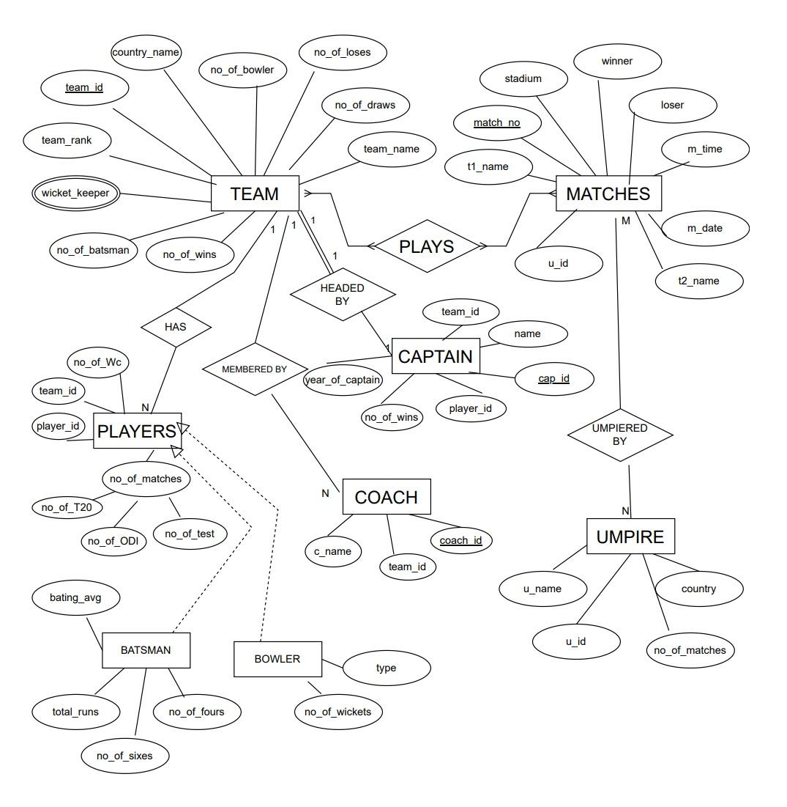
ENTITY RELATIONSHIP DIAGRAM

Slide 10
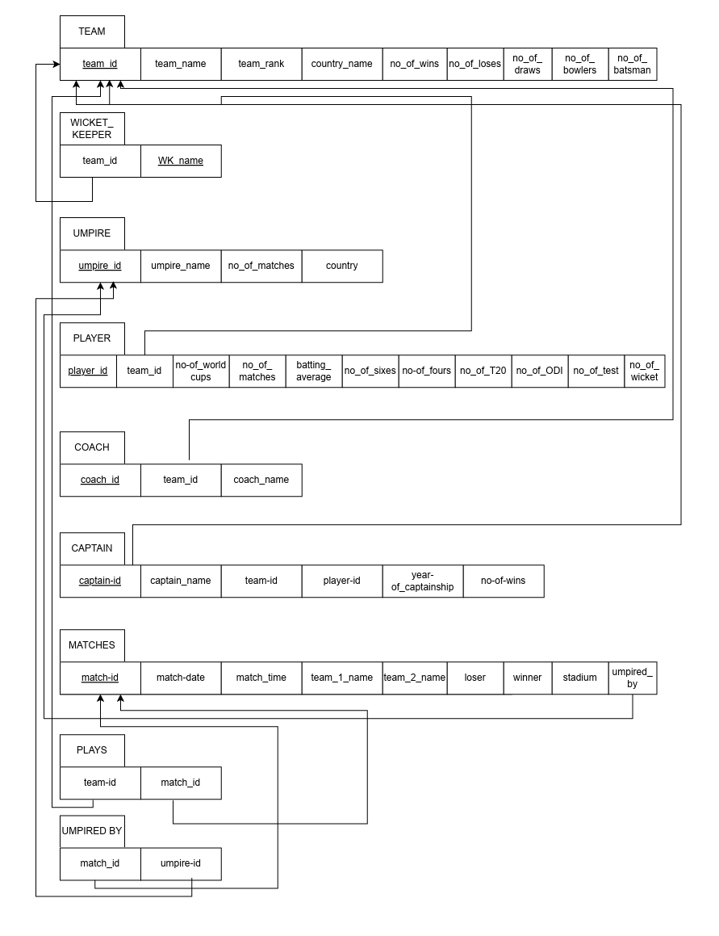
RELATIONAL DATABSE SCHEMA

Slide 11
TABLES
• Team
• Wicket Keeper
• Umpire
• Player
• Coach
• Captain
• Matches
• Plays
• Umpired By

Slide 12
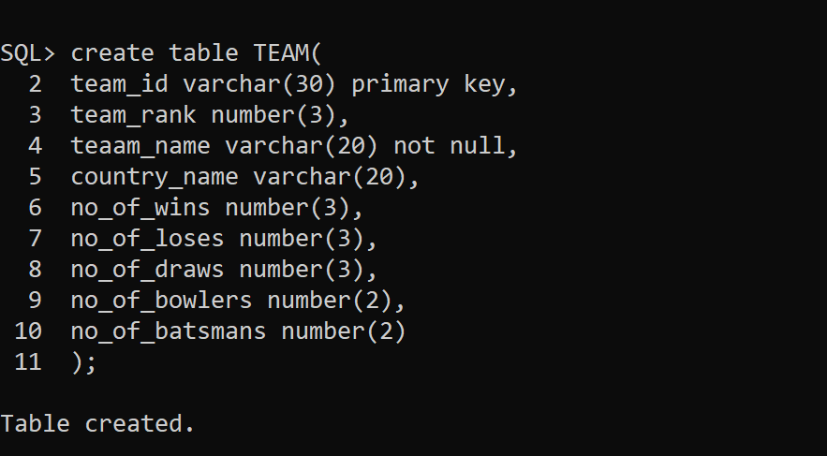
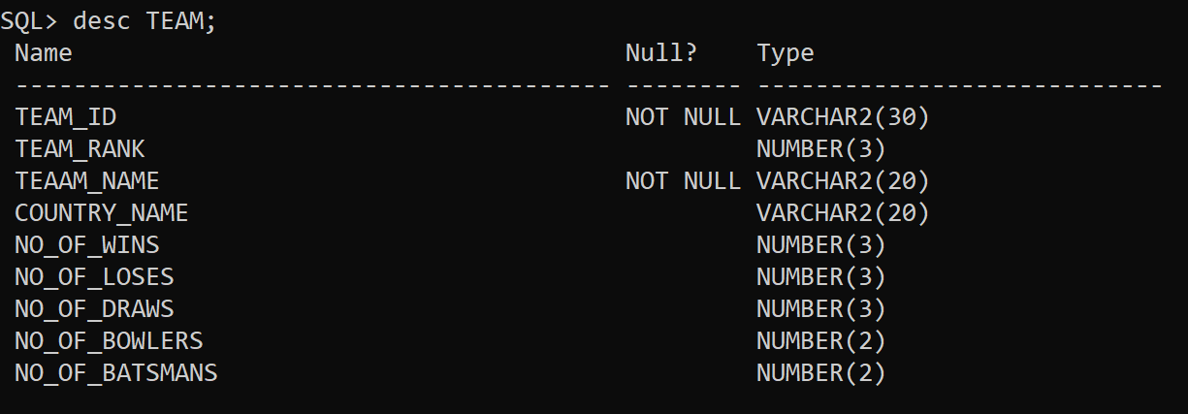
TABLE TEAM

Slide 13
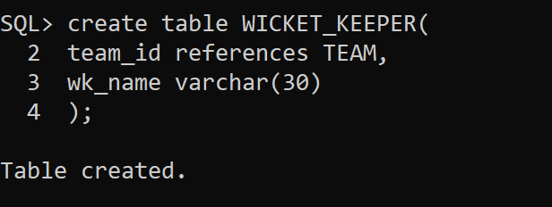
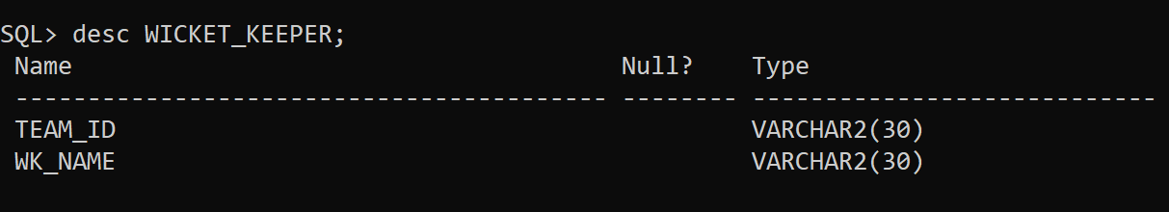
TABLE WICKET_KEEPER

Slide 14
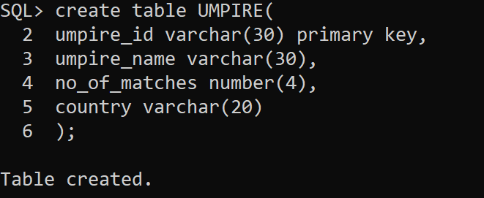
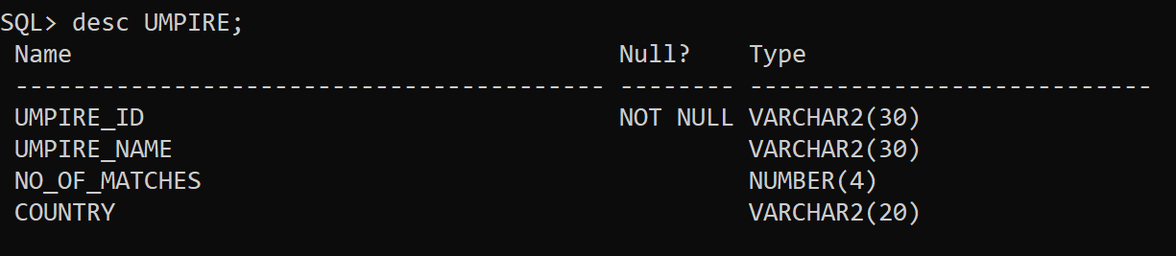
TABLE UMPIRE

Slide 15
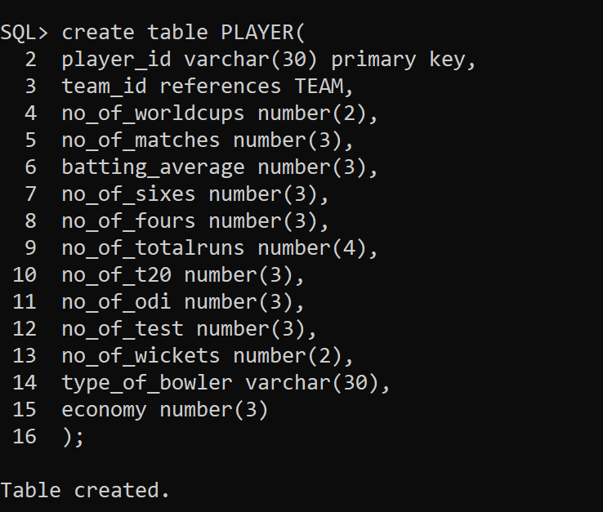
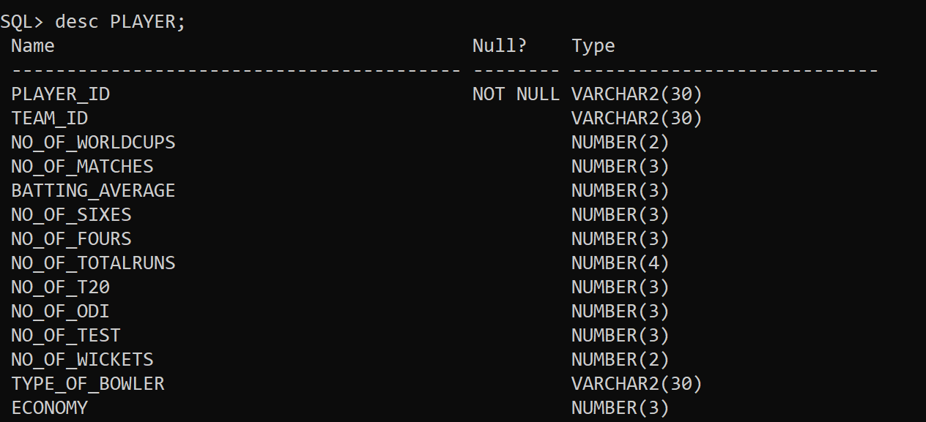
TABLE PLAYER

Slide 16
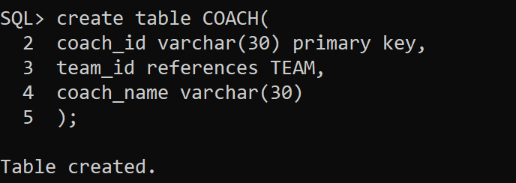
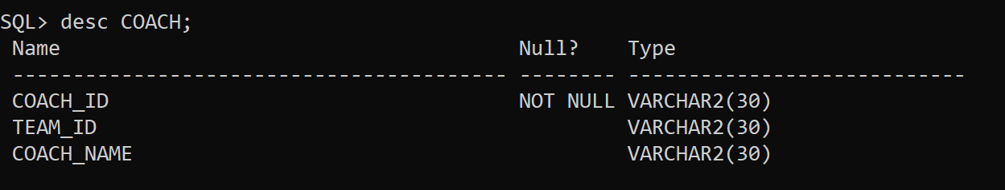
TABLE COACH

Slide 17
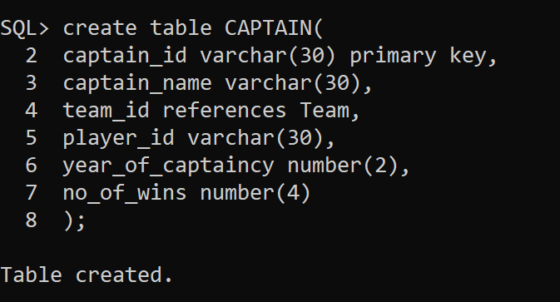
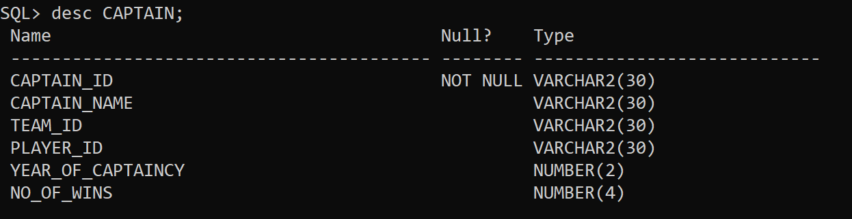
TABLE CAPTAIN

Slide 18
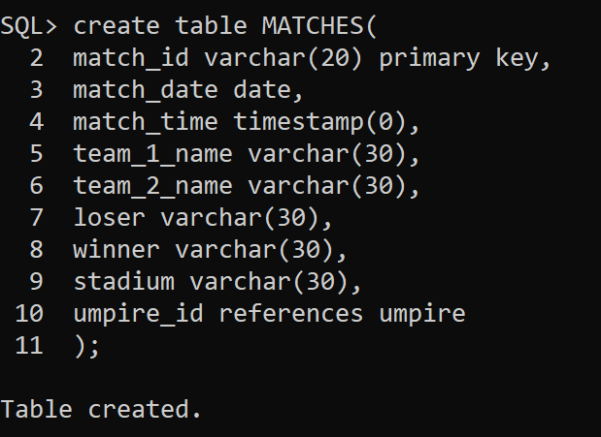
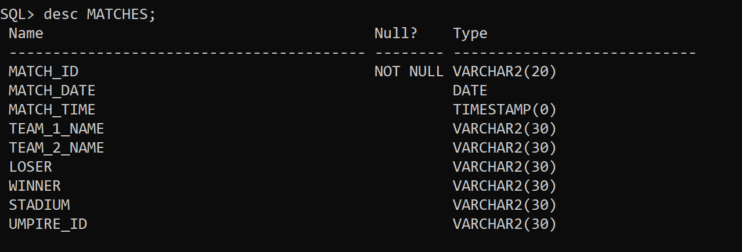
TABLE UMPIRE

Slide 19
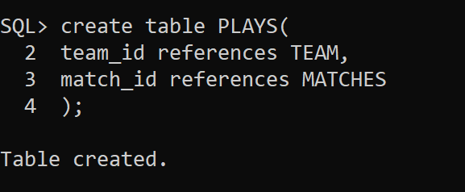
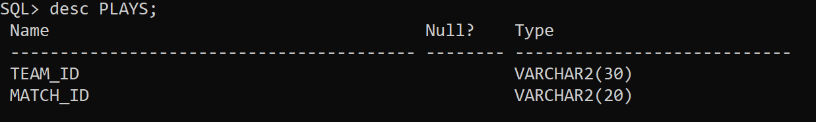
TABLE PLAYS

Slide 20
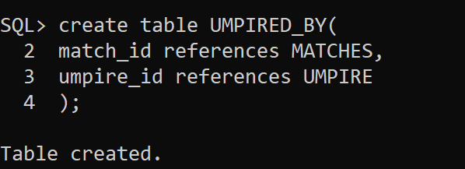
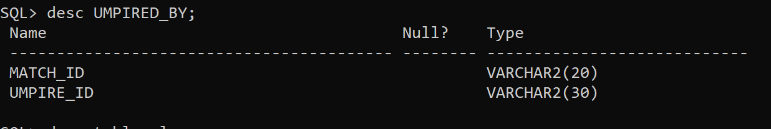
TABLE UMPIRED_BY

Slide 21
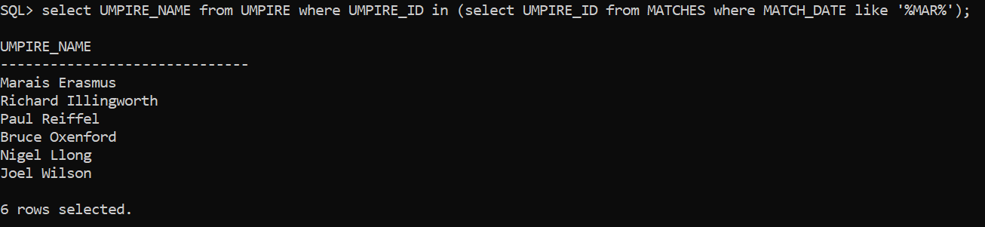
SQL QUERIES
EMBEDDED SELECT:
QUERY:
select UMPIRE_NAME from UMPIRE where UMPIRE_ID in (select UMPIRE_ID from MATCHES where MATCH_DATE like '%MAR%');
EXPLANATION:
The query returns the UMPIRE_NAMEs corresponding to the UMPIRE_IDs retrieved from the sub-query.
This provides a list of umpire names who officiated matches that occurred in March.

Slide 22
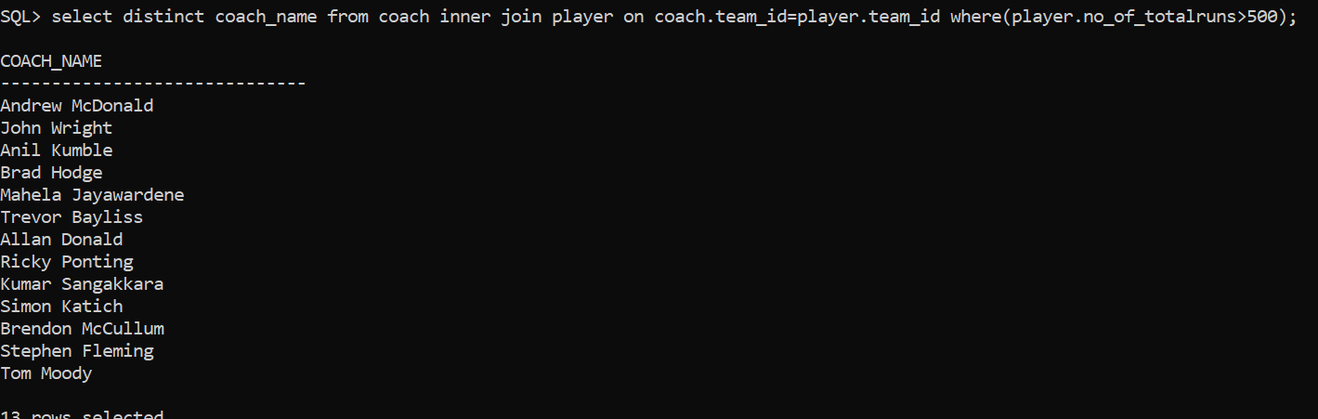
SQL QUERIES
INNER JOIN:
QUERY:
select distinct coach_name from coach inner join player on coach.team_id=player.team_id where(player.no_of_totalruns>500);
EXPLANATION:
The query will return a list of distinct coach names (coach name) who are associated with teams where at least one player has scored more than 500 total runs.

Slide 23
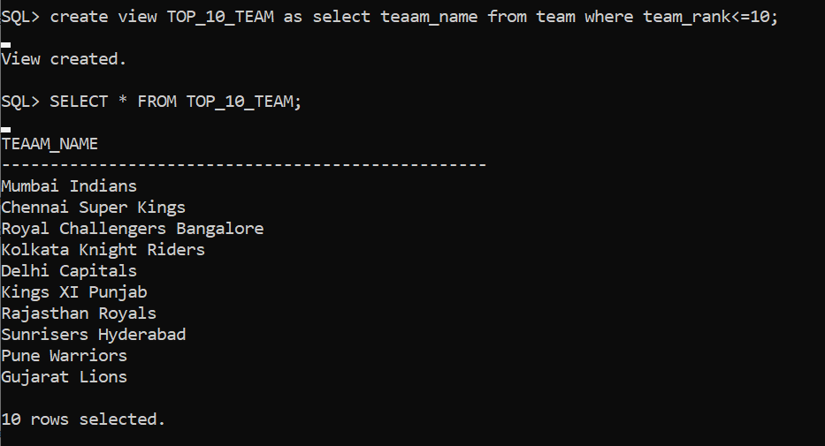
VIEWS
QUERY:
create view TOP_10_TEAM as select team_name from team where team_rank<=10;
EXPLANATION:
We give an PRESS report about the top ten team of the series we create an view.

Slide 24
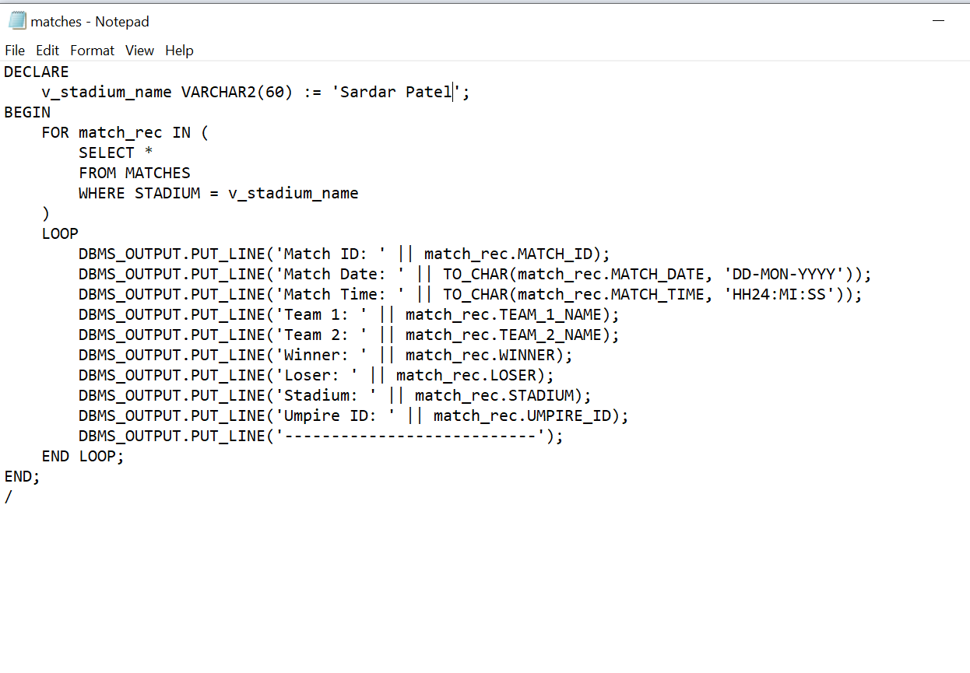
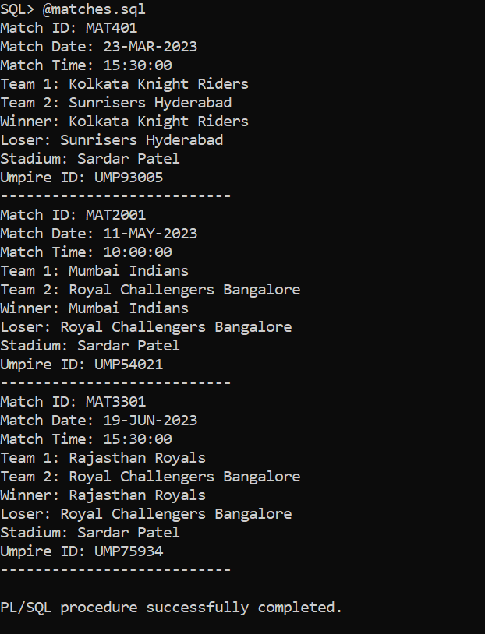
PL/SQL COMMANDS
PL/SQL Code to retrieve details of the matches which are held at Sardar patel stadium.
PL/SQL CODE:
RESULT:

Slide 25
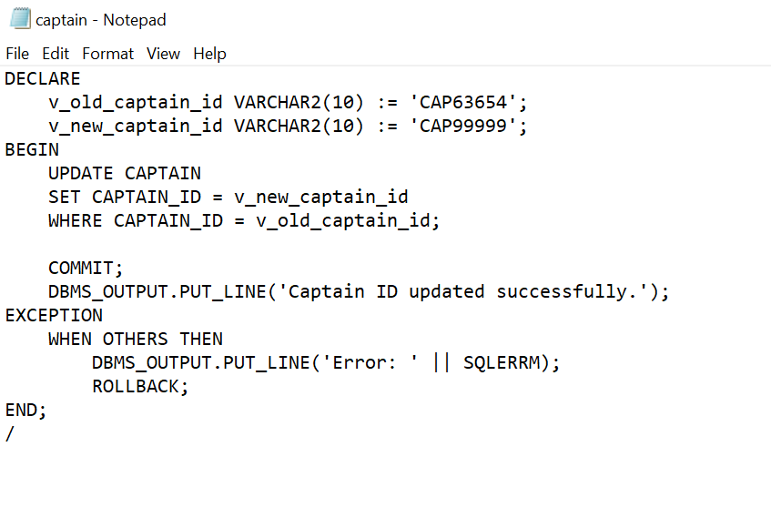
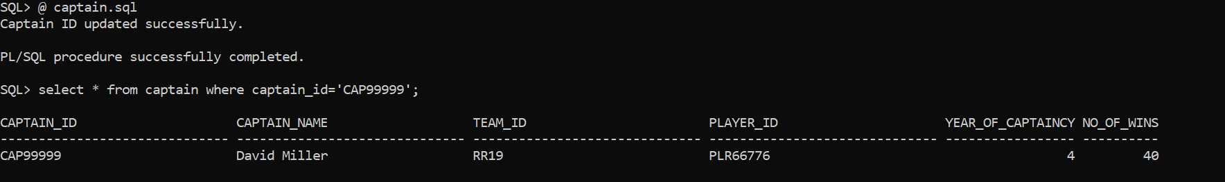
PL/SQL COMMANDS
PL/SQL Code to update the captain id of the captain table.
PL/SQL CODE:
RESULT:

Slide 26
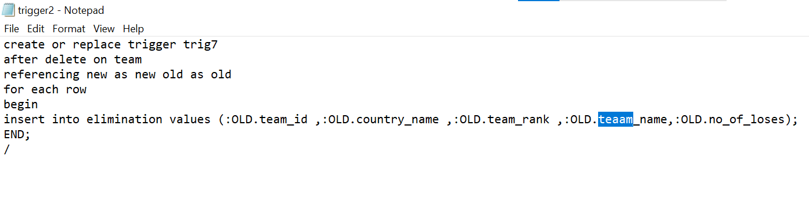
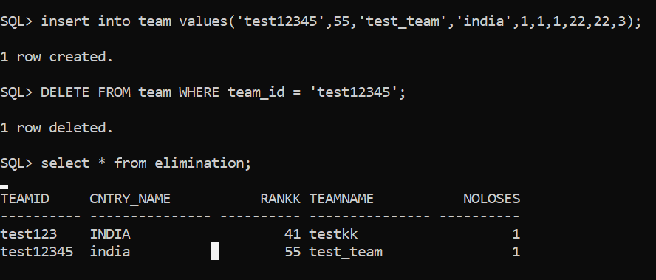
TRIGGERS
When a team is eliminated, do the necessary process and update the elimination table.
TRIGGER CODE:
RESULT:

Slide 27
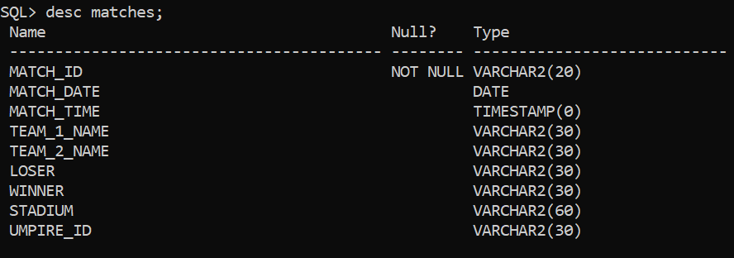
NORMALIZATION – 1NF
TABLE MATCHES:
FUNCTIONAL DEPENDECIES:
MATCH_ID -> MATCH_DATE, MATCH_TIME, TEAM_1_NAME, TEAM_2_NAME, LOSER, WINNER, STADIUM, UMPIRE_ID (CLOSURE)
MATCH_DATE, MATCH_TIME -> MATCH_ID (PARTIAL DEPENDENCY)
Since partial dependency exists we undergo 2NF.
The table is already in 1NF since all the instances of the attributes are atomic and no multi values exist.

Slide 28
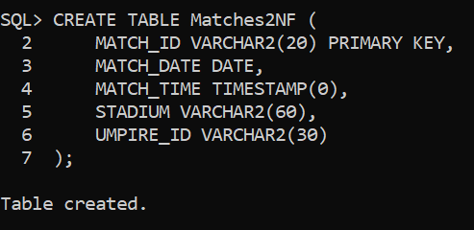
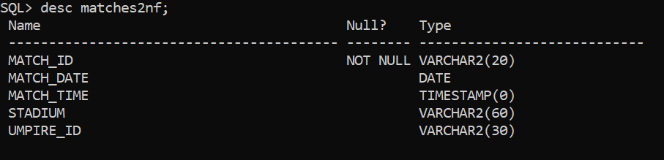
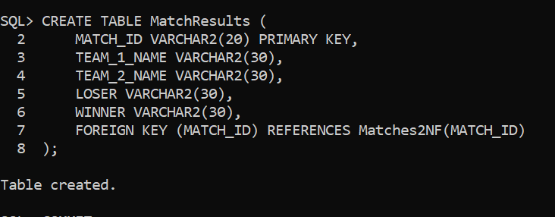
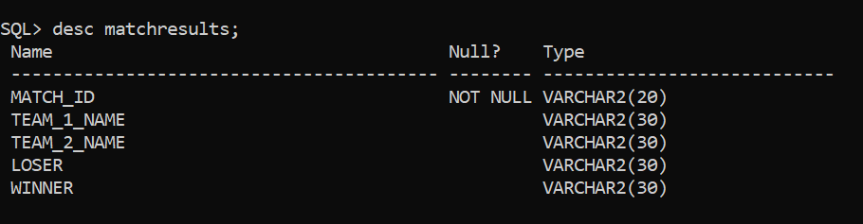
NORMALIZATION – 2NF
FIRST TABLE: Matches2NF
TRANSITIVE DEPENDENCIES:
MATCH_DATE -> MATCH_ID
UMPIRE_ID -> MATCH_ID
This means that UMPIRE_ID is transitively dependent on MATCH_DATE through MATCH_ID.
Since TRANSITIVE DEPENDENCY exist we are undergoing 3NF.
SECOND TABLE: MatchesResult

Slide 29
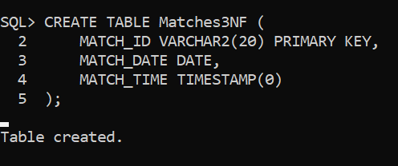
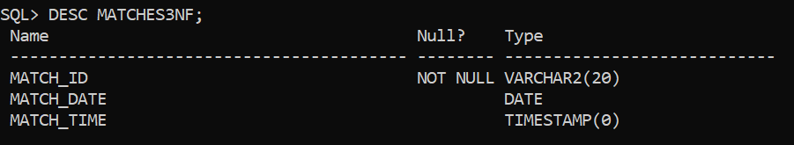
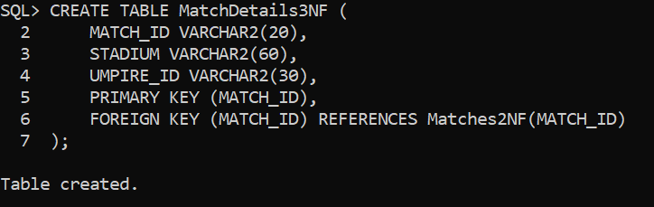
NORMALIZATION – 3NF
FIRST TABLE: Matches3NF
Each table represents a distinct entity with no non-key attributes functionally depending on other non-key attributes within the same table.
The Table MATCHES is finally NORMALIZED.
SECOND TABLE: MatchDetails3NF

Slide 30
TRANSACTIONS
T1:
BEGIN TRANSACTION
READ player_name FROM player WHERE player_id = 'PLR33889';
COMMIT TRANSACTION;
T2:
BEGIN TRANSACTION
UPDATE player SET team_id = 'RCB03' WHERE player_id = 'PLR33889';
COMMIT TRANSACTION;
T3:
BEGIN TRANSACTION
READ player_name FROM player WHERE player_id = 'PLR33889';
COMMIT TRANSACTION;
T4:
BEGIN TRANSACTION
UPDATE player SET team_id = 'MI01' WHERE player_id = 'PLR33889';
COMMIT TRANSACTION;
T5:
BEGIN TRANSACTION
READ player_name FROM player WHERE player_id = 'PLR33889';
COMMIT TRANSACTION

Slide 31
CONCURRENCY CONTROL
Transaction T1:
Begin Transaction
Read player_name FROM player WHERE player_id = 'PLR33889';
Commit Transaction
Transaction T2:
Begin Transaction
Read player_name FROM player WHERE player_id = 'PLR33889';
If the record is locked by T1, wait or retry later
Otherwise, update player SET team_id = 'RCB03' WHERE player_id = 'PLR33889';
Commit Transaction
Transaction T3:
Begin Transaction
Read player_name FROM player WHERE player_id = 'PLR33889';
If the record is locked by T1 or T2, wait or retry later
Otherwise, proceed with further actions or queries
Commit Transaction
Transaction T4:
Begin Transaction
Read player_name FROM player WHERE player_id = 'PLR33889';
If the record is locked by T1, T2, or T3, wait or retry later
Otherwise, update player SET team_id = 'MI01' WHERE player_id = 'PLR33889';
Commit Transaction
Transaction T5:
Begin Transaction
Read player_name FROM player WHERE player_id = 'PLR33889';
If the record is locked by T1, T2, T3, or T4, wait or retry later
Otherwise, proceed with further actions or queries
Commit Transaction

Slide 32
CONCURRENCY CONTROL
T1 can read the data without any issue because it's the first transaction.
T2 needs to wait if T1 is still reading the same record because it intends to update it.
T3 waits if T1 or T2 is modifying the record but can proceed if they are only reading.
T4 waits for all previous transactions (T1, T2, T3) to finish before attempting to update.
T5 waits until all previous transactions have completed before performing its actions.

